Slide 1
Successful Investment with Quantum 2012
Quan Nguyen, Ph.D
Chief Executive Officer
HQ Investment & Consulting Corporation
and
Professor at Computer Sciences Department,
University of Sciences, HCM city, Vietnam

Slide 2
Agenda
Introduction
Why Automatic Trading ?
Quantum System
Case Study
Conclusion

Slide 3
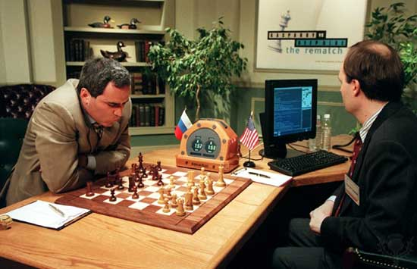

Slide 4
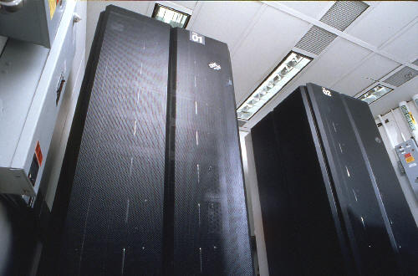
Deep Blue
Deep Blue was a parallel computer IBM RS/6000
200 million nodes per second,
30 billion positions per move
After the dispute Garry Kasparov wrote:
"The decisive game of the competition was the second, which left a scar in my memory ... we saw something that was beyond our expectations about the most amazing ability of a computer would have to predict the consequences of their decisions on positional long term. The machine refused to make a move to a position that would have a decisive advantage in the short term, showing a very human sense of danger. "

Slide 5
The rise of the machine
A third of all EU and US stock trades in 2006 were driven by automatic programs, or algorithms, (source: Boston-based financial services industry research and consulting firm Aite Group)
As of 2009, high-frequency trading firms account for 73% of all US equity trading volume
300 securities firms and hedge funds that specialize in this type of trading took in roughly US$21 billion in profits in 2008 (source: TABB Group, a financial services industry research firm)

Slide 6
Quantitative Trading Approach
Quant investment
Traditional investment
Using modeling approaches to invest and reduce risks. Avoid psychological influences.
Some tools used in Quantitative Trading
Technical analysis
Artificial Intelligent
Information Theory
Statistical Learning
Optimal control Theory
Stochastic Differential Equations)
Top down approach
Macro analysis
Sector analysis
Company analysis
Fundamental approach (DCF, peers..)

Slide 7
Should we use quantitative investment in Vietnam ?
Vietnam Stock Market Reality
T+4
Liquidity
Inefficient Market
Speculation
…
AND LACK OF TOOLS FOR VERIFING HYPOTHESES ABOUT INVESTMENT STRATEGY

Slide 8
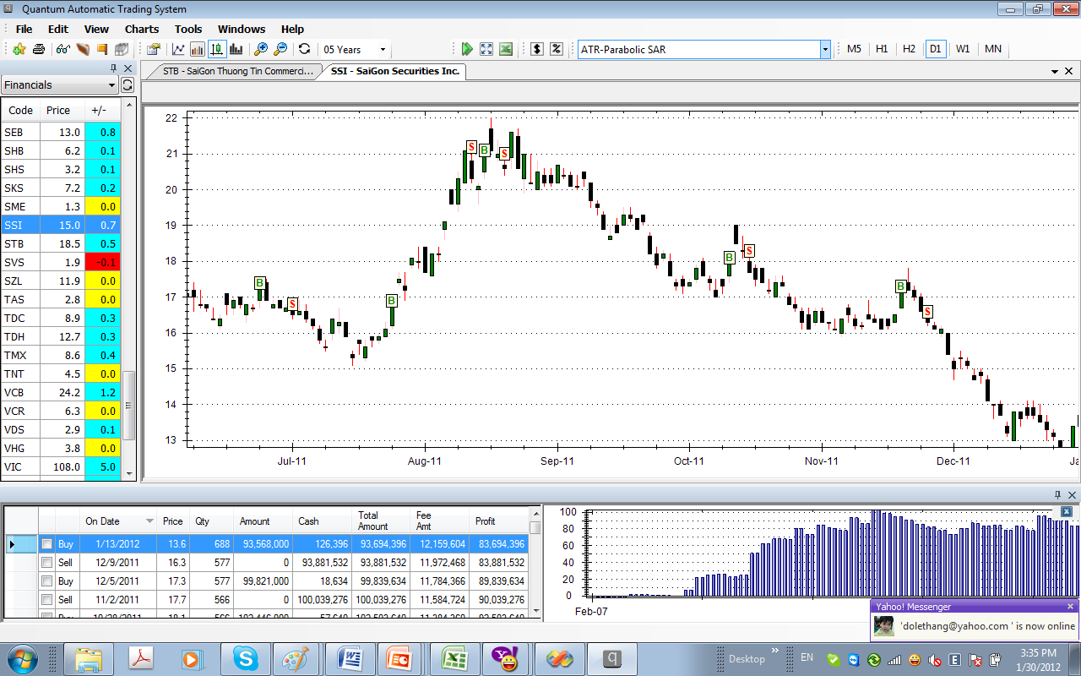
QUANTUM SYSTEM

Slide 9
Benefits
Built-in Experts Strategy
Avoid Psychologies Pitfall
Fits with different changes in economics situation
Reducing risk
Maximizing high performance profits over long term

Slide 10
Features
An expert system providing quantitative decisions
A 100% automatic trading analysis tool
Determine the ranking of all stocks with different customized criteria
Strategy Ranking
Automatic setting for trading algorithm
Advanced Money management

Slide 11
Trading software comparison
 | Quantum Pro | AmiBroker | MetaStock | VietStock Trader
Realtime Data | Realtime | Need Downloader | Need Downloader | Realtime
Charting
Watch lists
Transactions History
Buy/Sell Alerts
Technical indicators
Built-in Strategies |  | Need to develop | Need to develop | Few
Built-in Screening
Backtesting
Strategy ranking

Slide 12
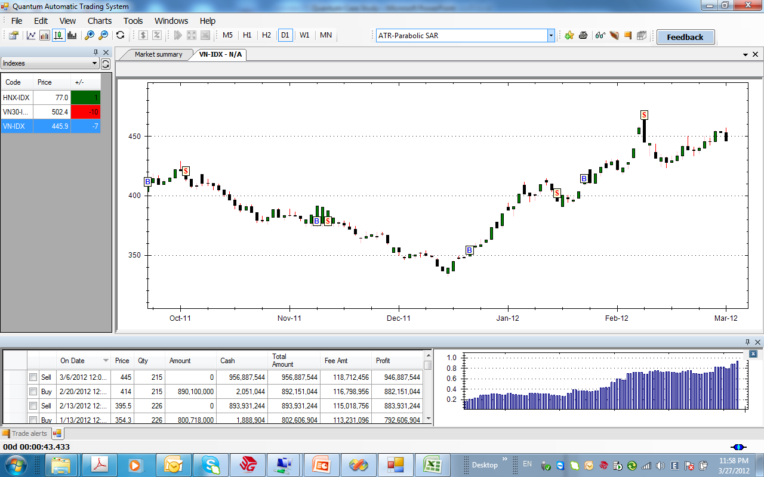
VNIndex Analysis

Slide 13
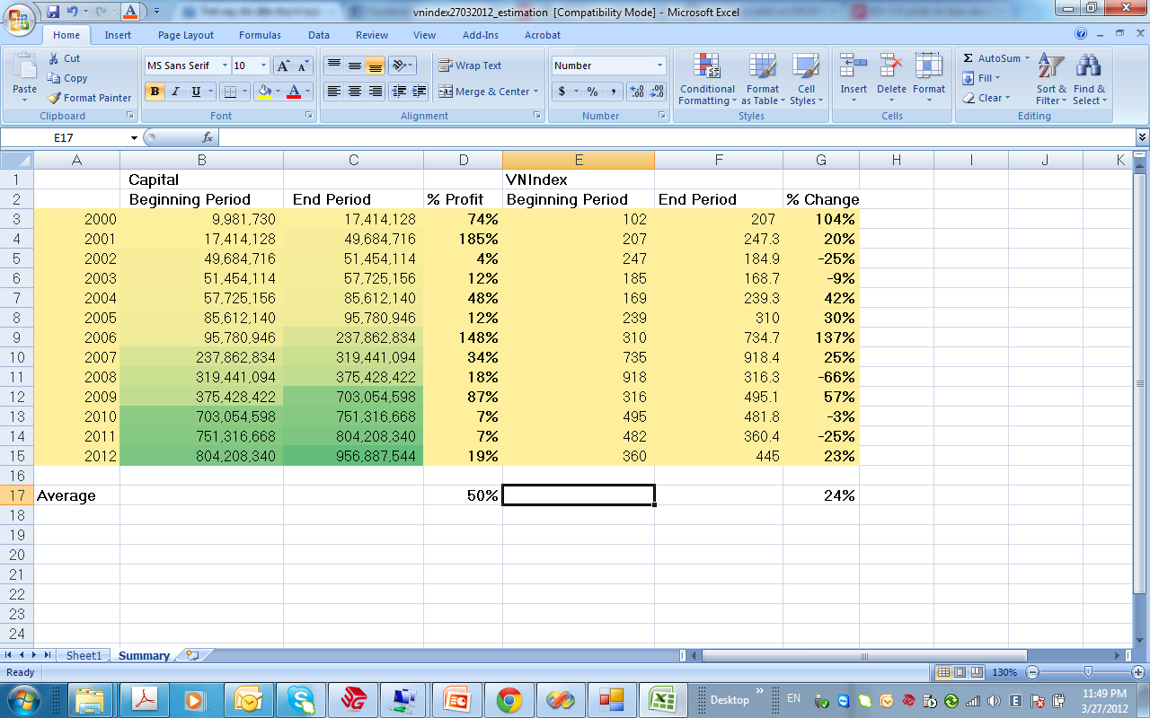
VNIndex performance vs Quantum Strategy

Slide 14
Quantum Algorithm
Determine the main trend of the market (using ADX, Bollinger, DMI,market indicator..)
Creating technical indicators and built-in formula to determine trend of individual stock (MACD, RSI, Aroon, japanese candlestick..)
Analysis of demand-supply force (Volume, ROC..)
Buy/Sell Decision, with Target, Stop Loss, Trailing Stop (fibonanci, elliot waves, support resistance…)
Money management (risk and profit)
Verification and parameters optimization

Slide 15
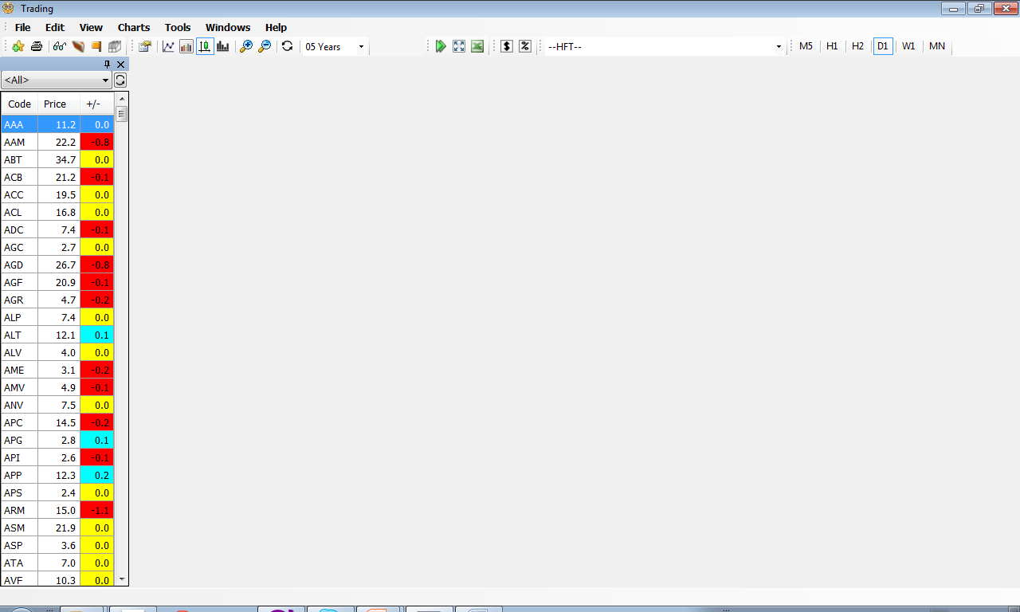
Main Screen of Quantum
The main screen for Quantum is where computer advices securities trading.
Investor don’t need to decide about timing
Risk is managed by computer strategy
Profits is maximized

Slide 16
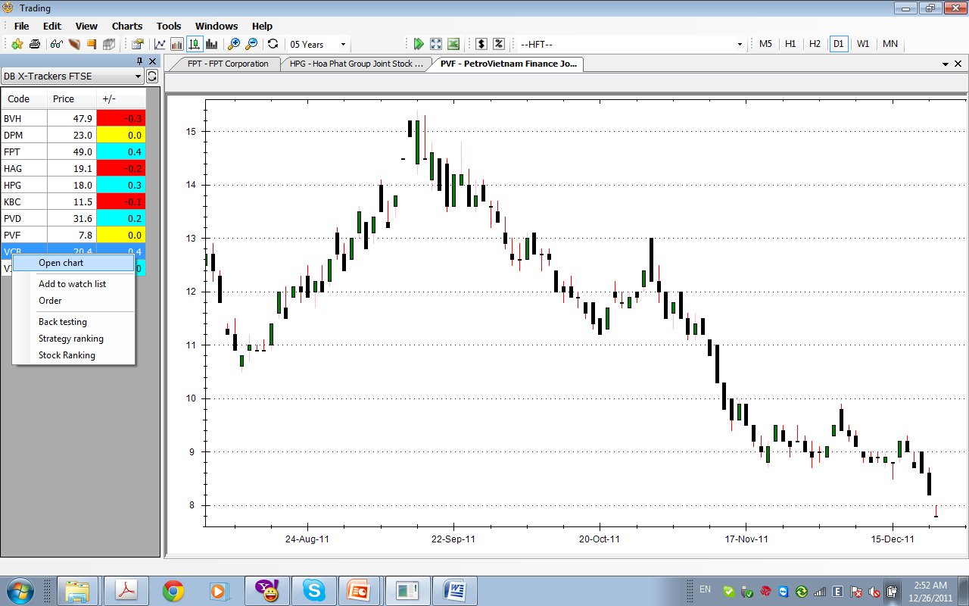
New Chart
New chart by double click or use contextual menu
Chart is drawn by default in candlestick style.
Other styles include Line and Bar
User can modifies chart’s colour in Chart->Chart Properties

Slide 17
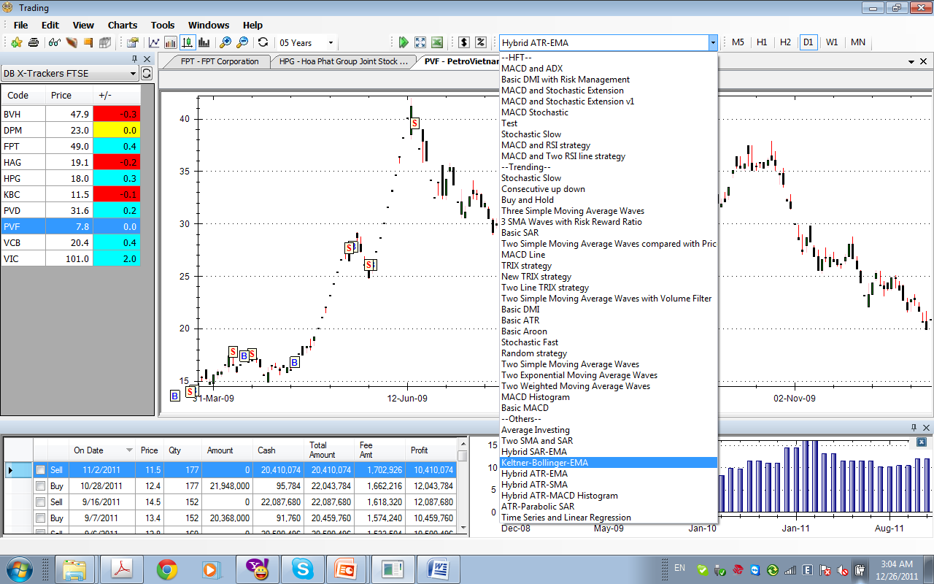
Quantum Decisions
Quantum provides automatic trading strategies
The strategy combobox show available strategies
Estimation window
Profit window

Slide 18
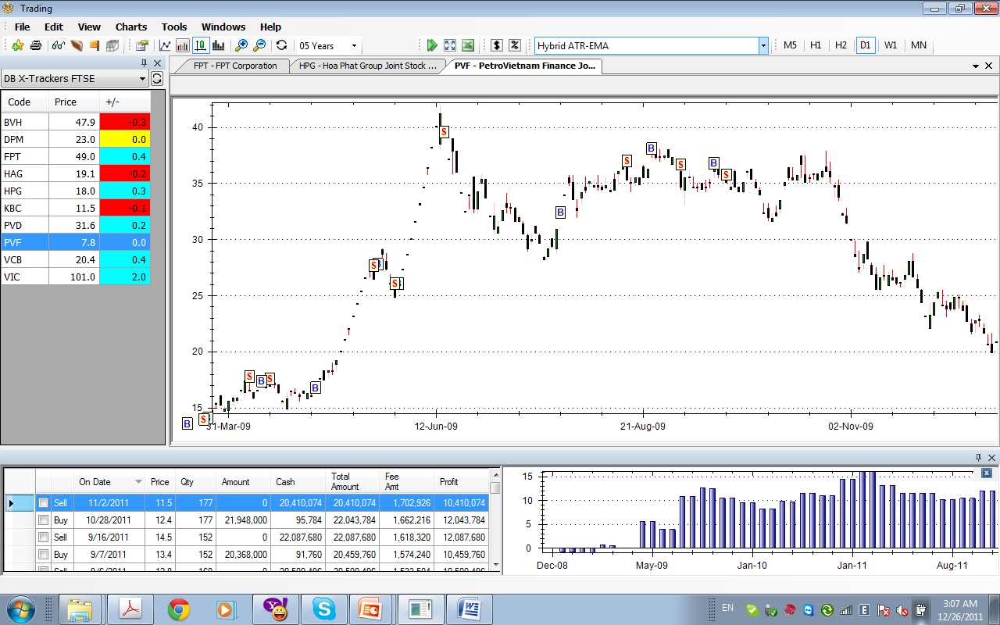
Quantum Automatic Trading Strategy
Help investors to find easily BUY/SELL decision
Increase PROFIT
Deacrese RISK
BUY/SELL decisions are shown in chart
More than 50 Quantum Strategy available

Slide 19
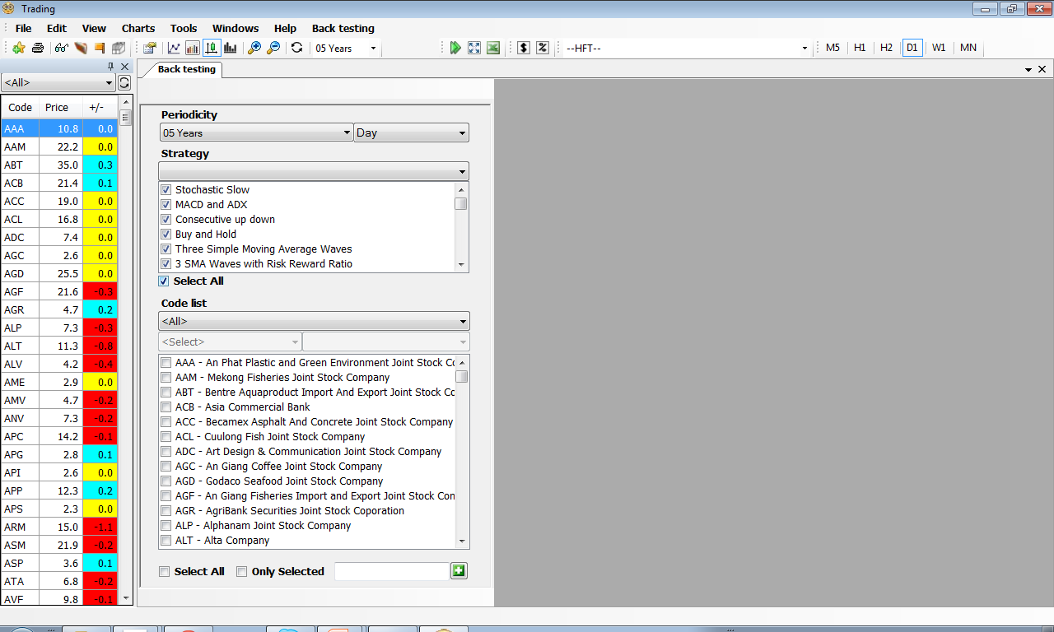
Back Testing
Backtesting is the process of evaluating a strategy, by applying it to historical data.
Many strategies can be chosen to do backtest
Strategy represents computer trading algorithm
Strategy list
Securities list

Slide 20
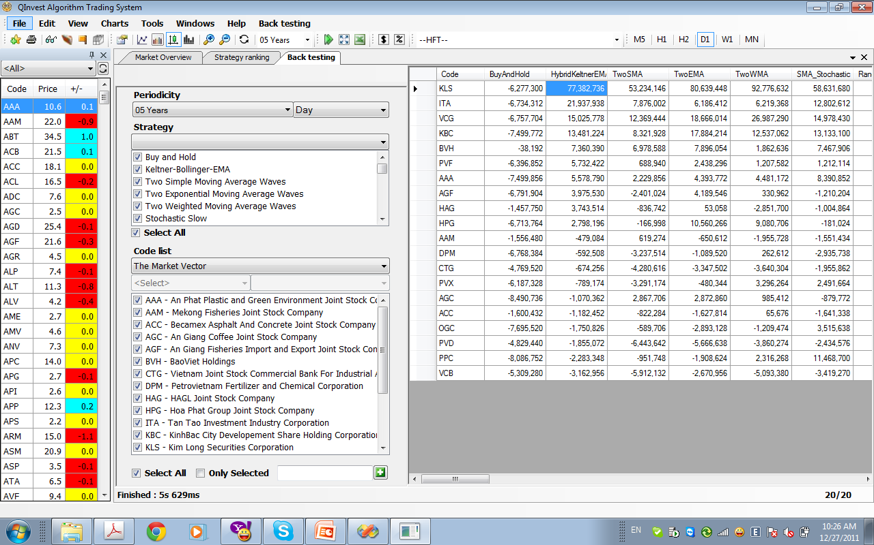
Back Testing (cont.)
Backtesting result allows investors to see the result of AUTOMATIC TRADING for a stock in a specific period
The value shows the profit/loss (in VND) for the investment of VND 10mil by default in the specific period

Slide 21
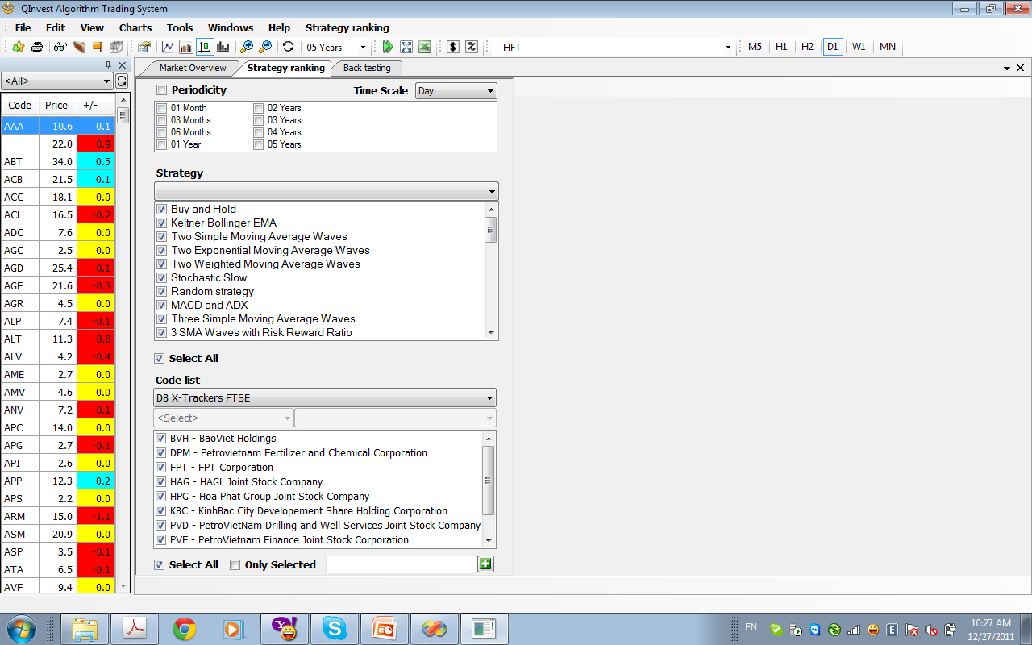
Strategy Ranking
Strategy Ranking helps investors find the best strategies for a stock
Many time-frame can be chosen to do the ranking
Investors can compare performance between different automatic strategy

Slide 22
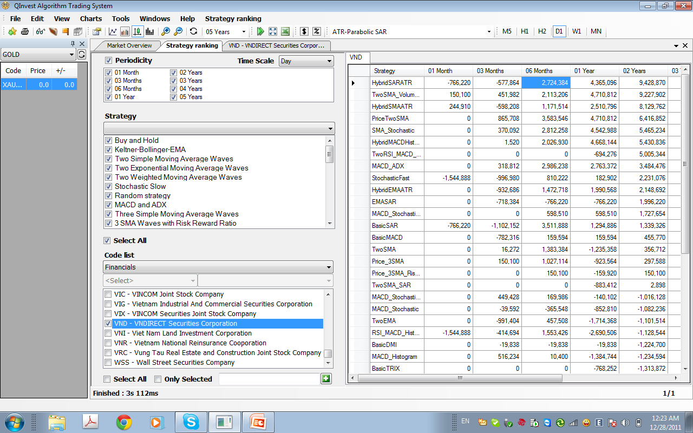
Strategy Ranking (cont.)
Strategy Ranking allows investors to sort the best strategy for a stock in a specific period
The value shows the profit/loss (in VND) for the investment of VND 10mil by default

Slide 23
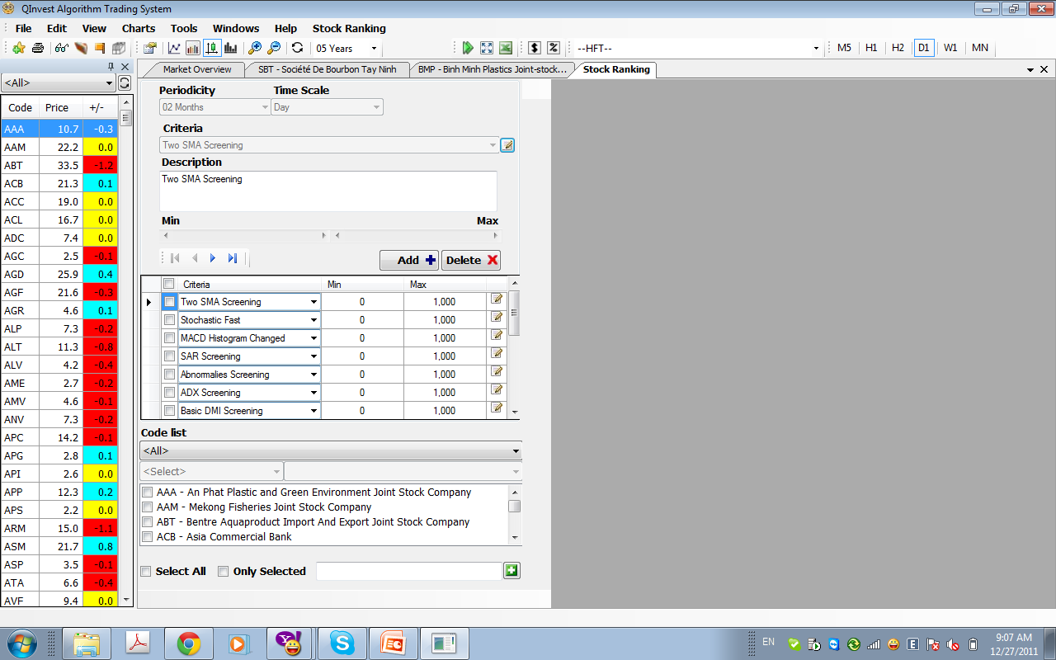
Stock Ranking
Stock Ranking is the process of selecting stocks by defined criteria.
Many stock ranking algorithm can be chosen
Stock Ranking is used by Portfolio Manager to find good stocks in order to outperform the market

Slide 24
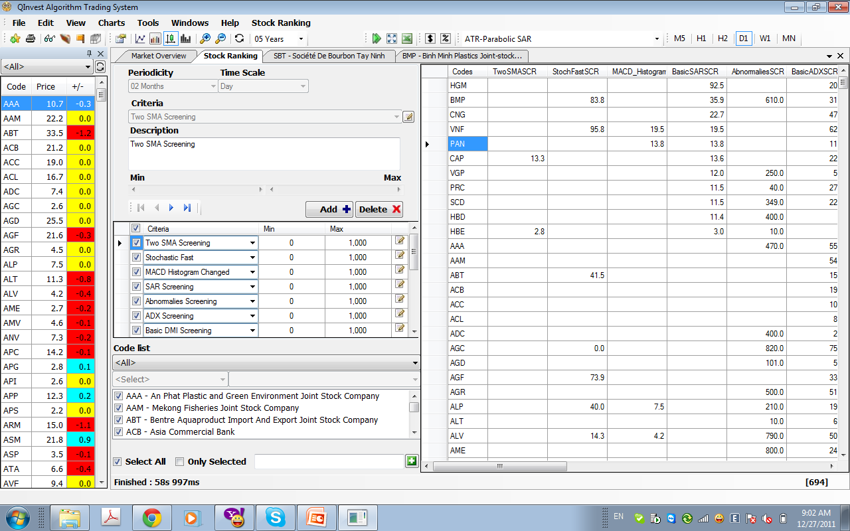
Stock Ranking (cont.)
Stock Ranking Result is shown in the right hand.
The value shows the weighted point for the ranking

Slide 25
Others functionalities
Technical Analysis Indicators
Trade Alerts
Portfolio Management

Slide 26
HQ Investment & Consulting Vietnam
Quantum is the product of HQ Investment & Consulting Vietnam.
Our mission is to use high-technology solutions to help end-users resolve their daily issues
Our value is based on truthiness, win-win attitude, creative and customer oriented
Contact us at
Email: info@hqcorporation.net
Web : http://www.q-invest.net

